Slide 1
Crystal Reports and Cargospot
Danna Lei Criste
Aprilla Alexandra Nazi

Slide 2
Contents
DAY 1 AM
Setup
  Database (MS SQL server), update
  ODBC
  Crystal report tools (Seagate Crystal Reports, Crystal SQL Designer)
Basic ‘How To’
  Sample report creation
    Using database linking expert
    Using query file (.qry)
  Parameter passing
  Sorting, Grouping, and Totaling
  Using Formulas
  Subreports
DAY 1 PM
Crystal reports’ usage in CSP
  Reports Location
  Program.ini setting
  Reports menu
  CSP screens
  Excel format
  PDF Merging
  E-mails
  Report spec parameter table
  Client specific reports / Crystal Report Dir
DAY 2
Practical application

Slide 3
Setup
MS SQL Database setup, update
ODBC
Crystal Report Tools
http://wiki.champ.aero/display/TOOLS/Setting+up+Crystal+Reports+on+Local+Machine

Slide 4
Basic ‘How To’
Sample report creation
  Using database linking expert
  Using query file (.qry)
Parameter passing
Sorting, Grouping, and Totaling
Using Formulas
Subreports

Slide 5
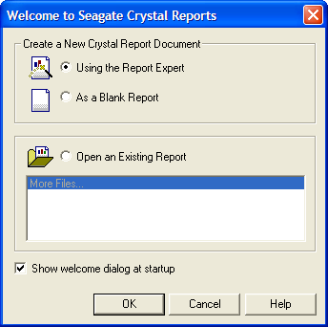
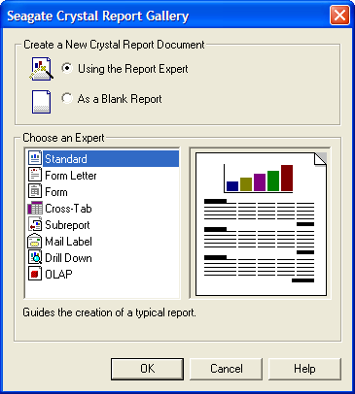
Report Creation

Slide 6
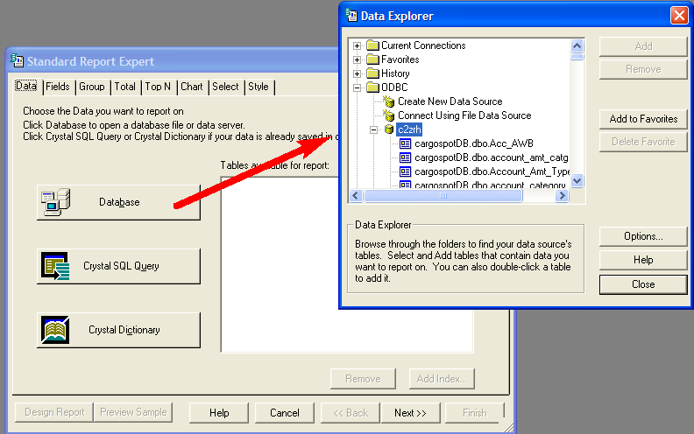
DB Linking Expert

Slide 7
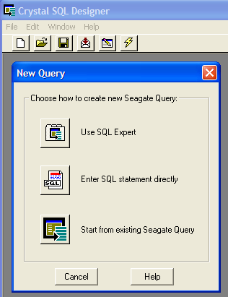
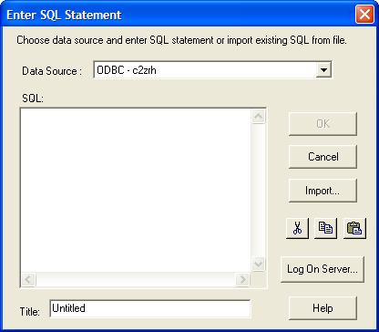
Query File (.qry)

Slide 8
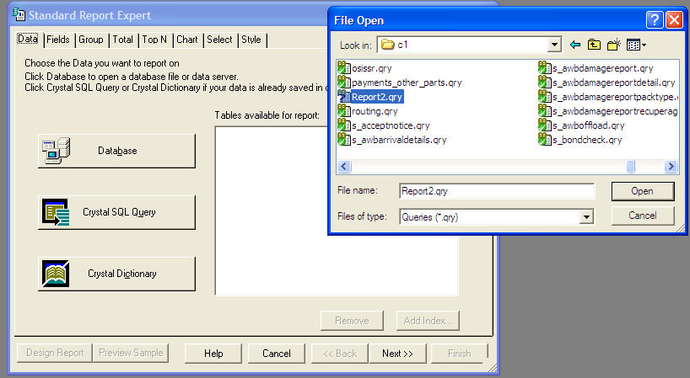

Slide 9
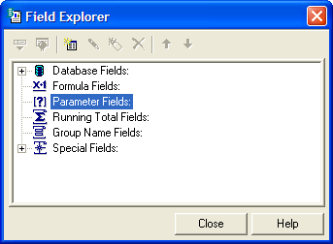
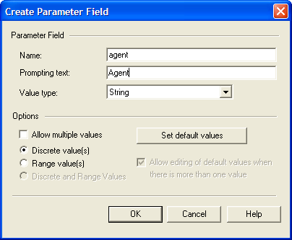
Parameter passing
Insert Menu > Parameter Field

Slide 10
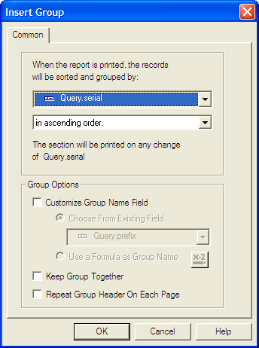
Grouping and Sorting Data
Insert Menu > Group

Slide 11
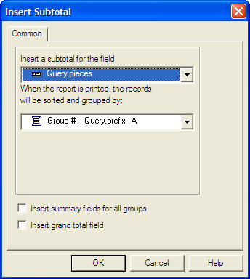
Subtotal, Grand Total, Summary
Subtotal
  Summary that totals or sums numeric values in a group
  Insert Menu > Subtotal

Slide 12
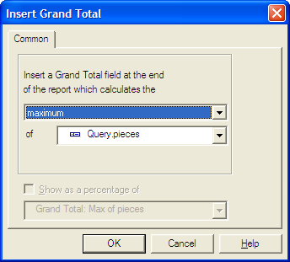
Subtotal, Grand Total, Summary
Grand Total
  Summarizes data at the end of the report
  Insert Menu > Grand Total

Slide 13
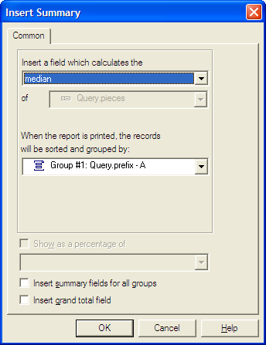
Subtotal, Grand Total, Summary
Summary
  Runs calculations on each group of records (i.e. sum, average, maximum, minimum, count, etc.)
  Insert Menu > Summary

Slide 14
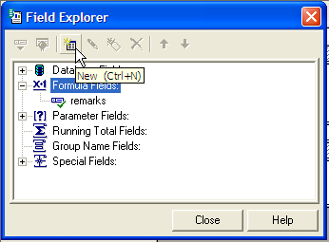
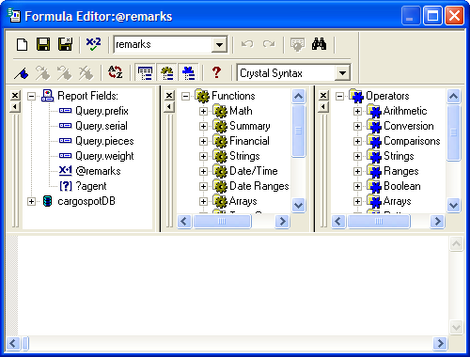
Using Formulas
Insert Menu > Formula Field

Slide 15
Using Formulas
Fields
  database: {Awb.seq}
  Parameter : {?agent}
  Formula: {@formula}
  Running total: {#runningTotal}
Statements
  Declaring variables
    numberVar v1;
    stringVar v2;
  Assignment
    V2 := 1;
  Comments
    //comment

Slide 16
Using Formulas
Statements
  If-Else
    If(condition1) then “do this” else “do that”
  Comparison
    Equal: =
    Not equal: <>
Built-in functions and operations

Slide 17
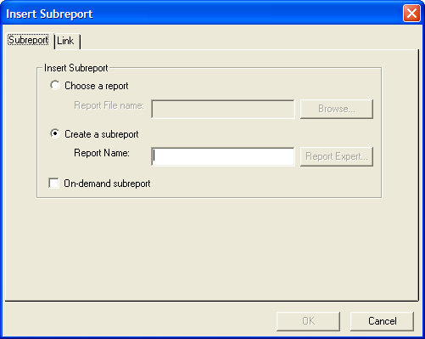
Subreport
Insert Menu > Subreport

Slide 18
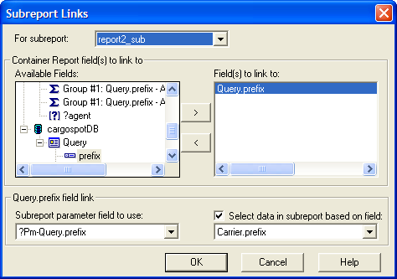
Subreport
Link subreport to main report
  Right Click subreport > Change Subreport Links

Slide 19
Crystal reports’ usage in CSP
Reports Location
Program.ini setting
Reports menu
CSP screens
Excel format
PDF Merging
E-mails
Report spec parameter table
Client specific reports / Crystal Report Dir

Slide 20
Reports Location
Generic Reports
  Location when committing in trunk : cargospot\rep\c1
Client-specific Reports
  Location when committing in trunk: cargospot\rep\xx
  xx = client IATA code
  Location when deployed in the server: /cargospot/server/resources/reports
Server location after implementation of new packaging
  /cargospot/server/resources/reports

Slide 21
Program.ini
Local Setup
old packaging
  [rep]
  outDir=./out
  outUrl=file://D:/CSP/svn-projects/trunk/cargospot/out
new packaging:
  [rep]
  outDir=./out
  outUrl=file://D:/CSP/server/out

Slide 22
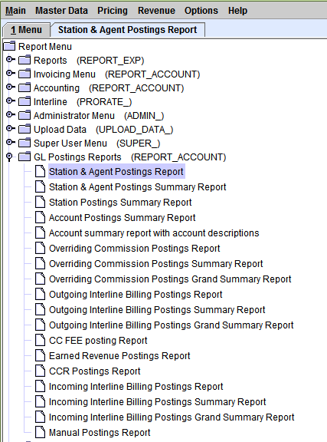
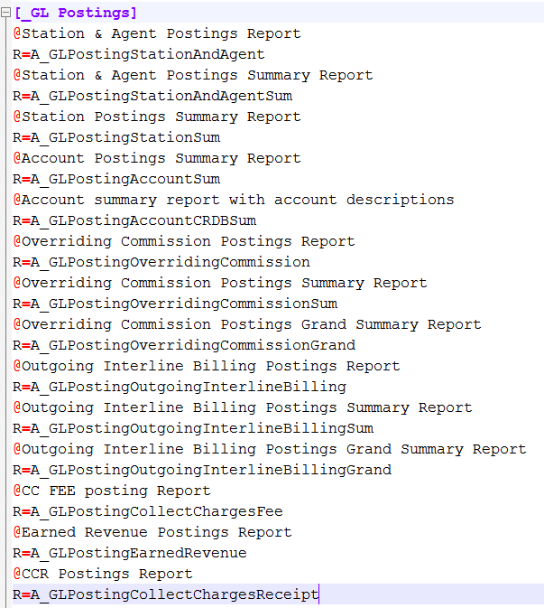
Reports Menu (menu_g.ini)
Example:

Slide 23
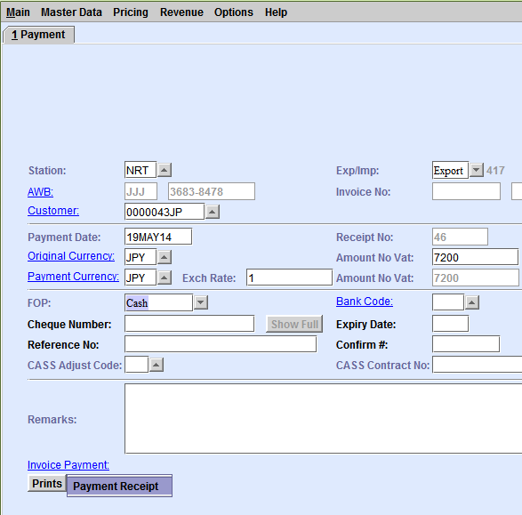
Cargospot Screens
Example Code:
private void printReport(final String reportName,
final String outName,
final boolean useAwbStation)
{
  Vector vec = new Vector();
  vec.addElement(reportName);
  vec.addElement("");
  vec.addElement("");
  CrystalArgument.addOperStation(vec);
  vec.addElement(new CrystalArgument("seq", pay.seq()));
  vec.addElement(new CrystalArgument("amount_text",
  Format.amountInWords(pay.amount + pay.vatAmount, originalAmountTxt.getFract())));
  if (isCourier())
  {
  vec.addElement(new CrystalArgument("remarks", remarksTxt.getText()));
  }
  if (useAwbStation)
  {
  replaceStation(vec);
  }
  ReportSelect.procDialog(vec, null);
}

Slide 24
Excel Format
Make sure to align the fields in the report layout!!!
Sample Code for generating excel format of the report
  Vector vec = new Vector();
  vec.addElement(reportName); // report name
  vec.addElement("4"); // report type
  vec.addElement(""); // output – temporary file only
  CrystalArgument.addOperStation(vec);
  //insert Crystal Arguments for report parameters here
  vec.addElement(new CrystalArgument("is_excel", "Y"));
  ReportSelect.procDialog(vec, reportTitle, 0);

Slide 25
PDF Merging
c2.c1.srv.PdfMergerService
AccountRunReportServiceImpl.java – createAndCombineInterlineReports method
When individual reports (pdf) have been generated, add them to a vector.
Finally, add final filename of the merged files to the vector and pass them to the PdfMergerService

Slide 26
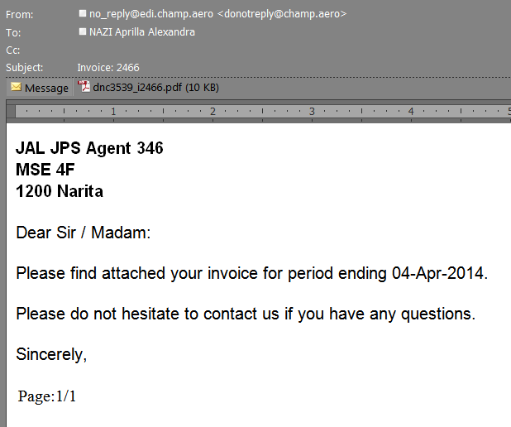
E-mails
Example: AccountRunSrv.java emailInvoice() method

Slide 27
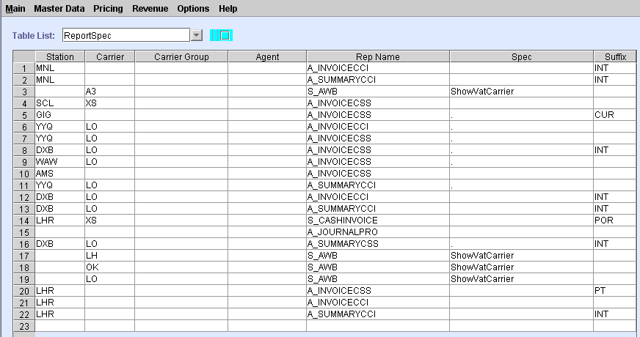
ReportSpec (View Master Codes)

Slide 28
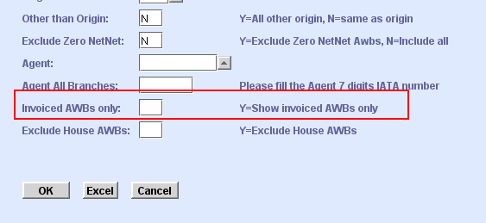
Report_help Table
Example:
insert into report_help values('invoiced_awb_only','Up~Range=YN~DispSize=1',
'Y=Show invoiced AWBs only',null,'Invoiced AWBs only','N');

Slide 29
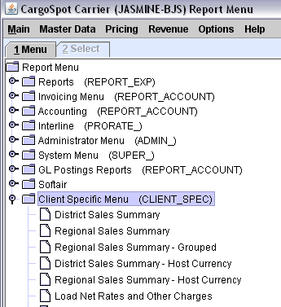
Client Specific Menu

Slide 30
Guidelines and References
http://wiki.champ.aero/display/PDLC/Crystal+Reports+Development+Guide
http://wiki.champ.aero/display/SUP/How+to+know+which+Cargospot+Reports+access+which+database+tables+and+columns

